Slide 1
myStudyPal
By: Spencer Loggia, Kaushik Srinivasan, Stephanie Zhang
Helping students work smarter, not harder by optimizing their performance on courses.

Slide 2
Meet Spencer
He’s currently taking 6 courses
Halfway into the semester, he has submitted few Homeworks and written midterms for each course.
Not all professors are giving him constructive feedback on his current performance in a timely manner.
Between classwork, lab work, and his job, he is very busy and needs to know how to optimize his time.
Does not know how he’s currently performing all his courses.

Slide 3
What can Spencer do?
Within reach…but not ideal!
Calculate Score Individually
Might take a significant amount of time. Lots of equations and non-linearities.
E-mail Professor
Professors might not be very responsive.. They don’t know overall grade.
Just Study More
There might be deadlines for other courses to keep. Cannot allocate all the time.

Slide 4
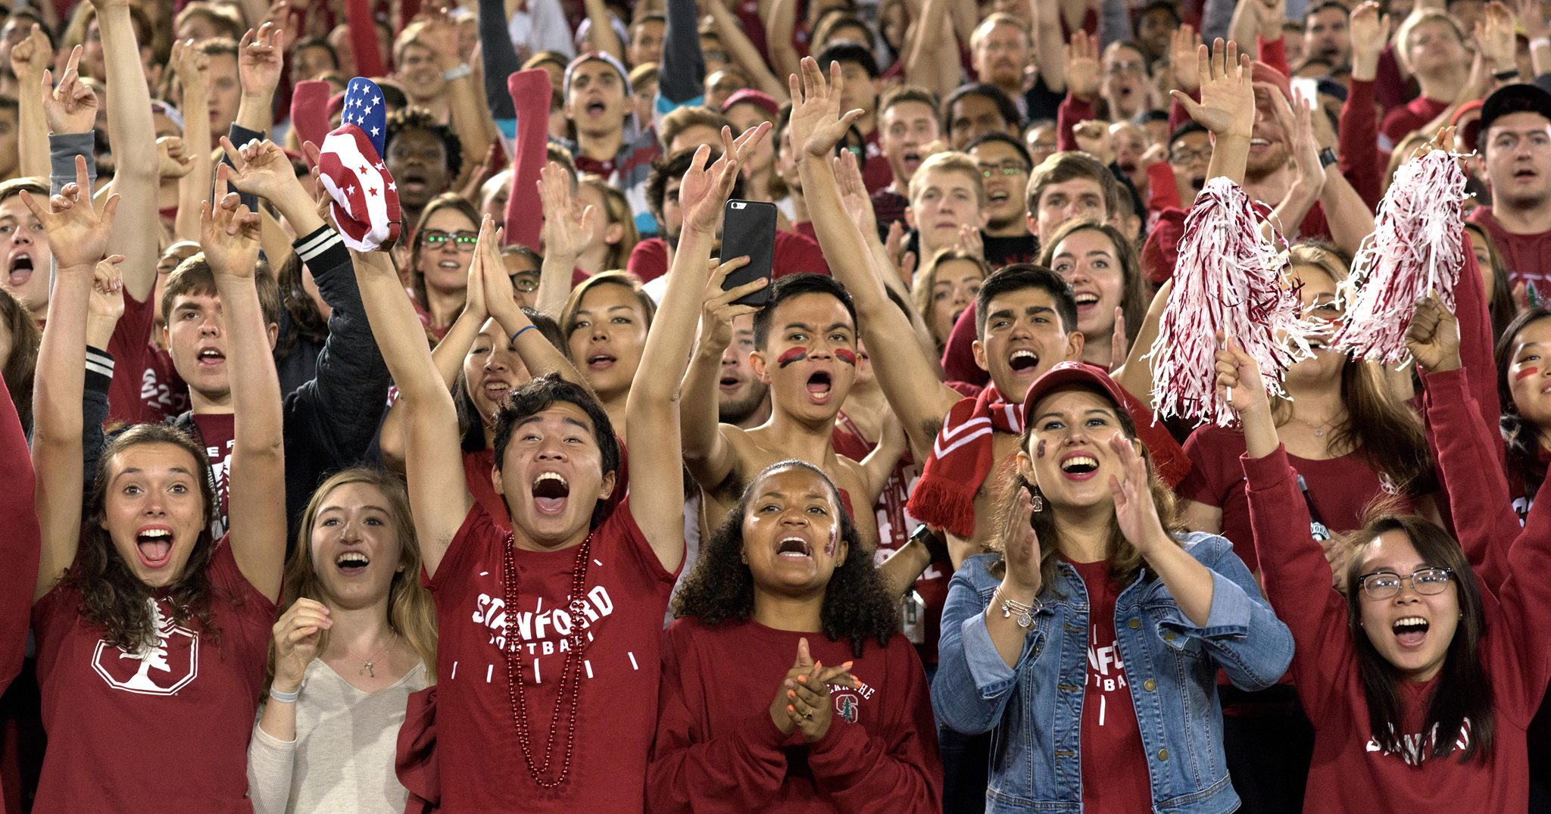
Problem: Students have no idea how they are currently performing in their courses and what measures they need to take to improve their performance.

Slide 5


What myStudyPal Provides
Assessment tracking
Course Feedback
Grade Optimization
1
2
3
Be able to track how you have been performing in assessments across all semesters. Graphs your improvements.
We look at all courses and factor in the non-linearities in the grades. Account for this and advise on which courses you need to concentrate on.
Uses a probabilistic machine learning algorithm to predict what you need in your future assignments to reach the next grade level.

Slide 6


Value Proposition
Constant information on performance throughout the semester
Less stress
Time saved

Slide 7
How myStudyPal does it
Now let’s assume that the student is in the middle of the semester and we have some data points
Midterms
Homeworks
0
80
90
Grade

Slide 8
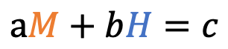
How myStudyPal does it
Now let’s assume that the student is in the middle of the semester and we have some data points
Midterms
We’ll get the equation
Homeworks
$$aM+bH=c$$
Where $c$ is the next grade level (e.g. 90 : A- )
0
80
90
Grade

Slide 9
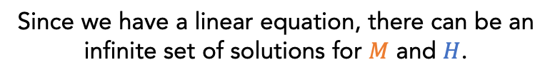
How myStudyPal does it
Now let’s assume that the student is in the middle of the semester and we have some data points
Midterms
We’ll get the equation
Homeworks
$$aM+bH=c$$
Where $c$ is the next grade level (e.g. 90 : A- )
Since we have a linear equation, there can be an infinite set of solutions for $M$ and $H$.
We need a cost function whose minimum is the optimal value.
0
80
90
Grade

Slide 10
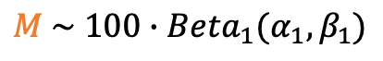
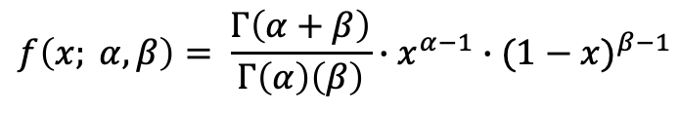
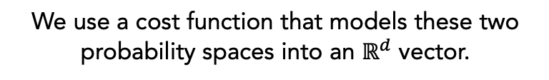
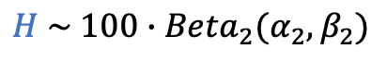
How myStudyPal does it
INTUITION: We model the data points as a Beta Distribution where
$$f\left(x; α, β\right)= \frac{Γ\left(α+β\right)}{Γ\left(α\right)\left(β\right)}∙x^{α−1}∙{(1−x)}^{β−1}$$
Midterms
Homeworks
$$M \sim {100∙Beta}_{1}(α_{1}, β_{1})$$
$$H \sim 100∙{Beta}_{2}(α_{2}, β_{2})$$
We use a cost function that models these two probability spaces into an $ℝ^{d}$ vector.
0
80
90
Grade

Slide 11
How myStudyPal does it
In our demo we used a Gaussian distribution to describe variance along each variable.
After lots of calculation and experimentation, we defined a scoring function that could suitably determine the ”value” of a certain set of scores on future (untaken) assignments.
It does this by taking into account the likelihood of occurrence gotten from the probability distribution, the benefit gained from reaching the next grade line, and the number of credits for the course.
Midterms
Homeworks
0
80
90
Grade

Slide 12
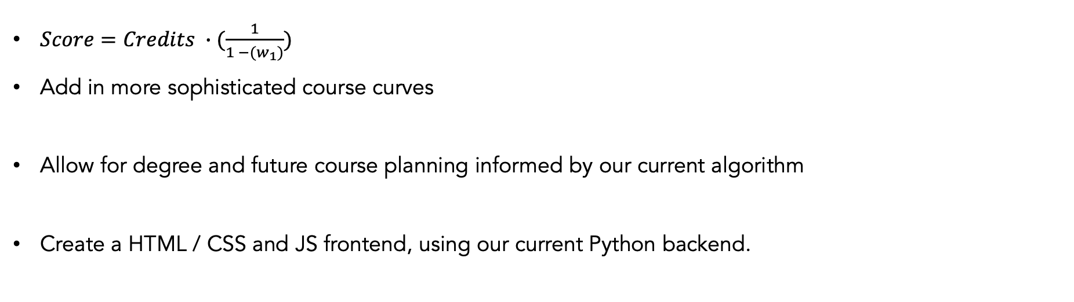
Moving Forward
$Score=Credits ∙(\frac{1}{1 −(w_{1})})$
Add in more sophisticated course curves
Allow for degree and future course planning informed by our current algorithm
Create a HTML / CSS and JS frontend, using our current Python backend.

Slide 13
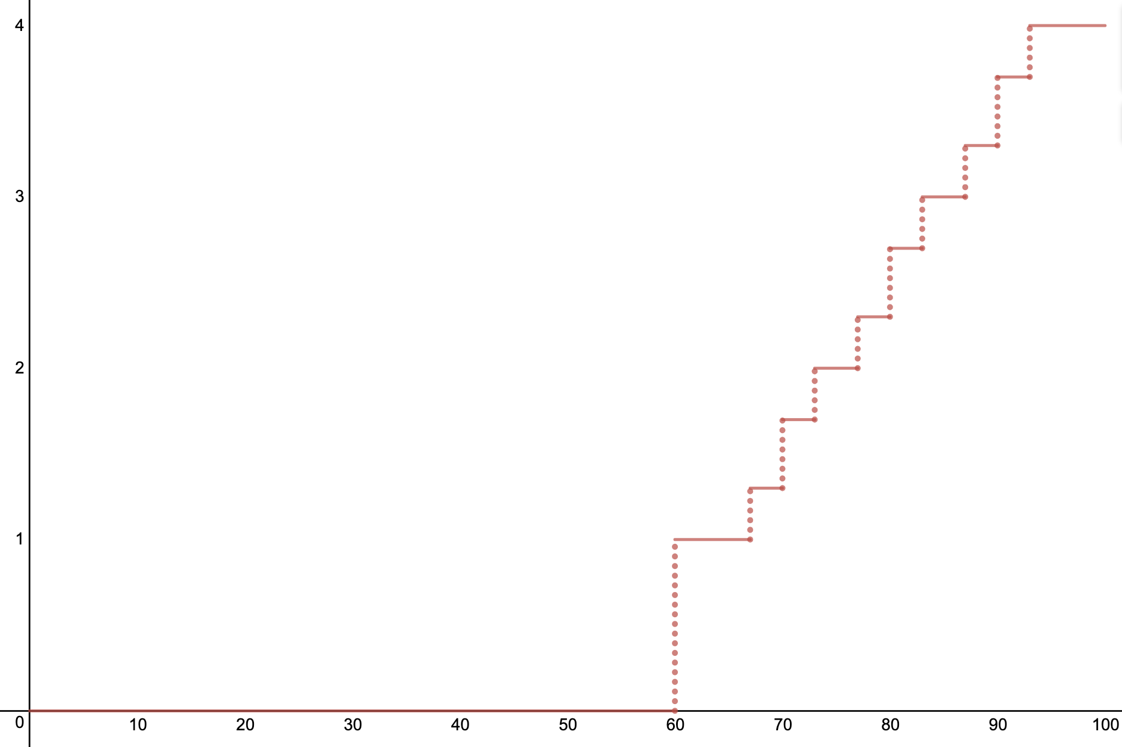
How myStudyPal does it
There also exists non-linearities in the GPA scale. Our algorithm accounts for this to ensure that you concentrate on the right courses to do the best in class.

Slide 14
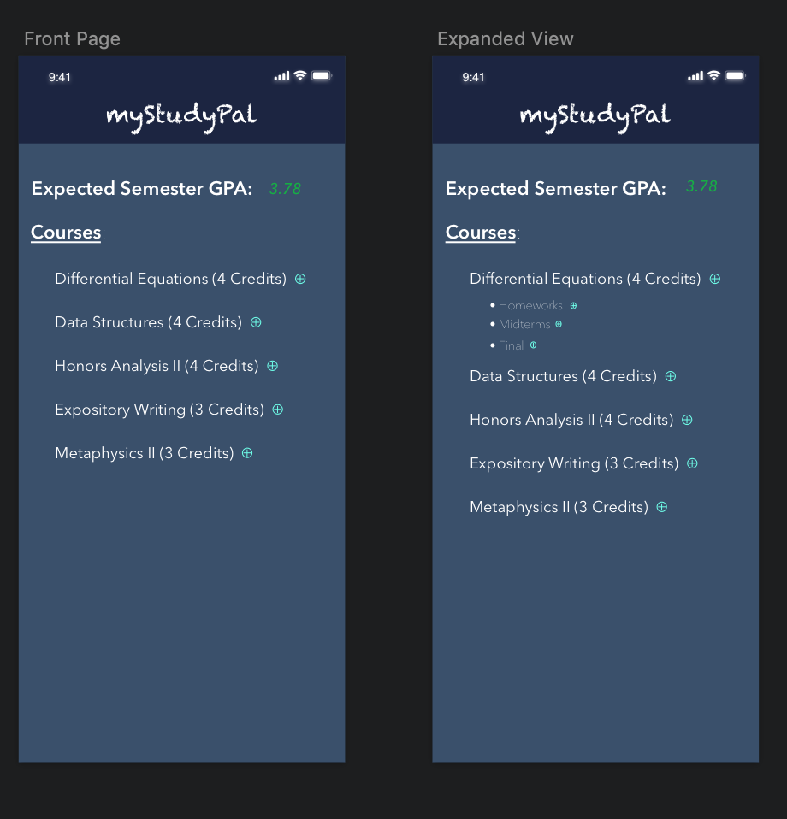
Moving Forward
Add previous semester courses to better inform probability distributions
Add in more sophisticated course curves
Allow for degree and future course planning informed by our current algorithm
Create a HTML / CSS and JS frontend, using our current Python backend.

Slide 15
Demo

